Slide 1
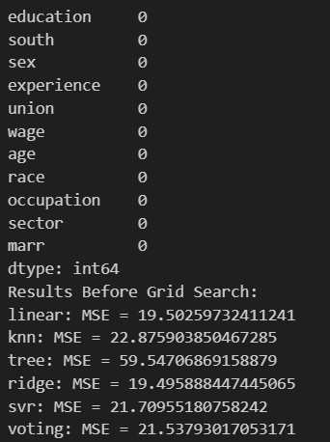
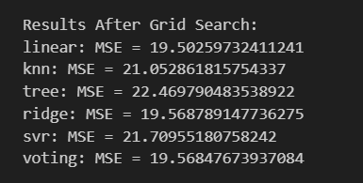
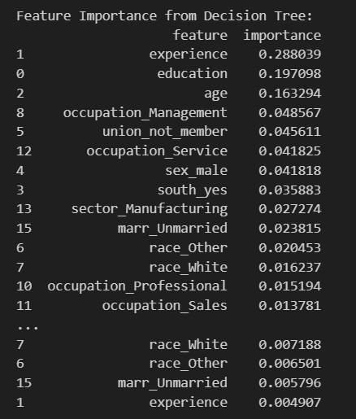
evaluating the performance of the Voting Regressor compared to individual models and explores feature importance for predicting wages.
Linear Regression and Ridge performed the best, so it could be a linear relationship between predictors and wages
KNN (21.05) and SVR (21.71) underperformed, indicating that local neighbors or kernel-based models may not generalize well for this dataset.
Decision Tree performed the worst (MSE = 22.47), likely due to overfitting
Voting Regressor MSE (19.57) is lower than most individual models, except Linear Regression (19.50).
The ensemble approach did not outperform the best individual models, possibly linear models might be sufficient. So wisdom of the crowd (ensemble learning) didn't provide a huge advantage over simpler models.
Experience, Education and Age are the strongest predictors of wage
Being in management has high wages

